Slide 1
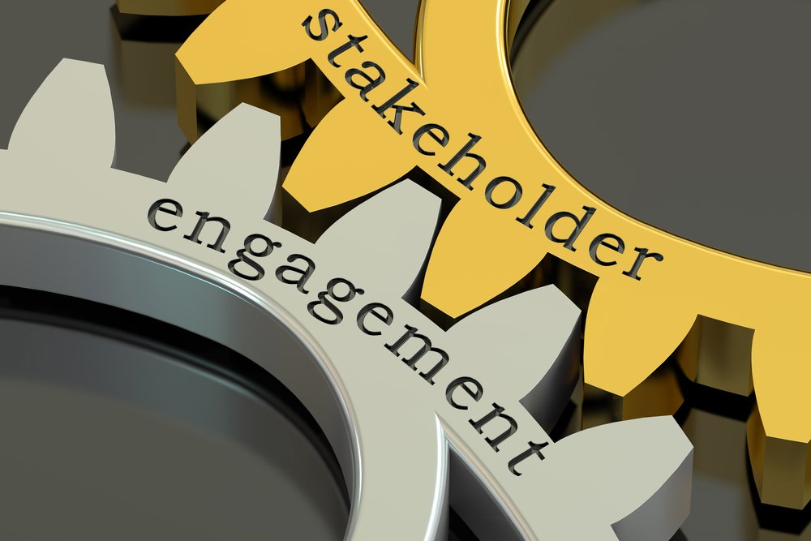
What is Stakeholder Engagement?
Stakeholder engagement is the process used by an organization to engage relevant stakeholders for a clear purpose to achieve agreed outcomes.
It is a fundamental accountability mechanism since it requires an organization to involve stakeholders in identifying, understanding and responding to issues and concerns, and to report, explain and answer to stakeholders for decisions, actions, and performance
Benefits of Stakeholder engagement
Proper stakeholder Engagement Ensures Risk-Free Project Delivery
Keeping Stakeholders Engaged Ensures Project Delivery
Stakeholders Are a Source of Project-Related Knowledge
Lead to more equitable and sustainable social development
Allow pooling of resources to solve problems
Who are Stakeholders?
Those groups who affect or could be affected by our services, and associated performance are known as Stakeholders
Internal Stakeholders
People within the organization involved in project delivery which includes: Project Manager, Owner, Resource manager, Team members.
External Stakeholders
People who can influence or be affected by the project and who don’t belong to the organization initiating the project which includes: Consultants, End users, Government, Investors, External sponsors

Slide 2
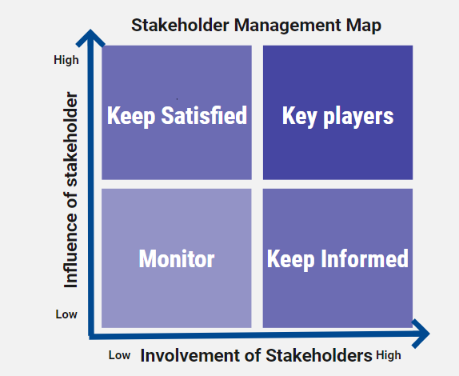
What is Stakeholder Mapping?
Stakeholder mapping is the visual process of laying out all the stakeholders of a product, project, or idea on one map. The main benefit of a stakeholder map is to get a visual representation of all the people who can influence your project and how they are connected.
Benefits of stakeholder mapping
Stakeholder mapping allows you to identify key players that will influence your project and its success.
1. Find out who has the most influence
Building a stakeholder map, to find out who has the highest level influence over a project
2. Focus on those who benefit most
Stakeholder maps helps to find out who benefit most from the end-product
3. See where resources are most plentiful
Often when you build a stakeholder map, you’ll see who has restraints on the project and who has more resources, so internally you can put the right people on your team.
4. Having a game plan
A stakeholder map gives you idea of who you’re trying to satisfy when building this product/project.

Slide 3
Stakeholder Engagement Strategy
Developing strategic stakeholder engagement involves five key steps:
1) Survey Your Stakeholders
Identify existing relationships, and survey them to learn new things about your stakeholders like whether they would be interested in participating and what issues are most important to them.
2) Prioritize Stakeholders by Interest and Influence
Using Stakeholder Mapping, segment your engagement according to their interest in being involved and their level of influence on particular issues.
3) Map Stakeholders to Measure ROI of Stakeholder Engagement
It’s necessary to measure the return on investment of your stakeholder engagement efforts by tracking your engagement throughout the year and re-mapping at the end of the year.
4) Communicate Company Activity Regularly
Consistently communicate company activity with the stakeholders. One way is to track who is opening and engaging with the emails, prompting opportunities for further engagement.
5) Log Meetings to Maintain Institutional Knowledge
Log meeting notes so that the information is maintained in an organized way in a digital system

Slide 4
Stakeholder Engagement Techniques
1. Identify stakeholders early When initiating projects, start identifying stakeholders
2. Get stakeholders talking to one another Key stakeholders to initial project meetings as they can help in developing the project charter and help resolve conflicts.
3. Seek to understand before being understood People want to know that you really want to hear their perspective first.
4. Listen to your clients Part of understanding is making time to listen to your clients. Ask probing questions.
5. Lead with integrity Trying to deliver what was promised or expected.
6. Engage your stakeholders in the estimates Help stakeholders to understand that there is greater uncertainty in the early estimates. Commit to providing refined estimates as your projects progress.
7. Work with your team Work with stakeholders to break down project into deliverables tasks.
8. Manage expectations Working as a team will clarify false expectations from the project.
9. Communication Develop and maintain a communications plan to minimize a potential communications breakdown.

